Slide 1
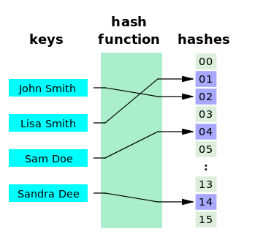
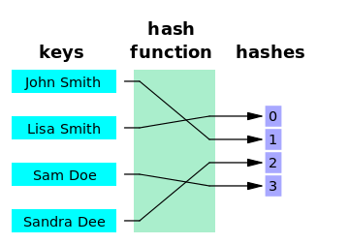
Perfect Hash Function
•If hash function h transforms different keys into different numbers, it is called a perfect hash function.
•If a function requires only cells in the table = data, it is called a minimal perfect hash function
•Cichelli’s method is an algorithm to construct a minimal perfect hash function

Slide 2
A Perfect Hash Function for strings
•Cichelli algorithm: find perfect hash functions for a given fixed collection of words.
•He proposes the hash function for each word:
h(word) = (length(word) + g(first_letter(word)) + g(last_letter(word))) mod TSize
•The function g is to be constructed so that h(s) is unique for each string s.
•For this to be a perfect hash function, the proper mapping of letters to integers is needed.

Slide 3
Perfect Hashing: Outline of Cichelli's Algorithm
Given a fixed collection of words, the Cichelli's algorithm proceeds thus:
1. Find the frequency of the first and the last letter of each word;
2.Then find the sum of the frequencies of the first and the last letter of each word;
3. Sort the words in descending order of frequency;
4. Go to the next word (select the next word from step 3);
5. Choose g-values for any unassigned first/last letters for the current word. If a conflict occurs, backtrack and choose again.
6. If there are more words to process, go to Step 4.

Slide 4
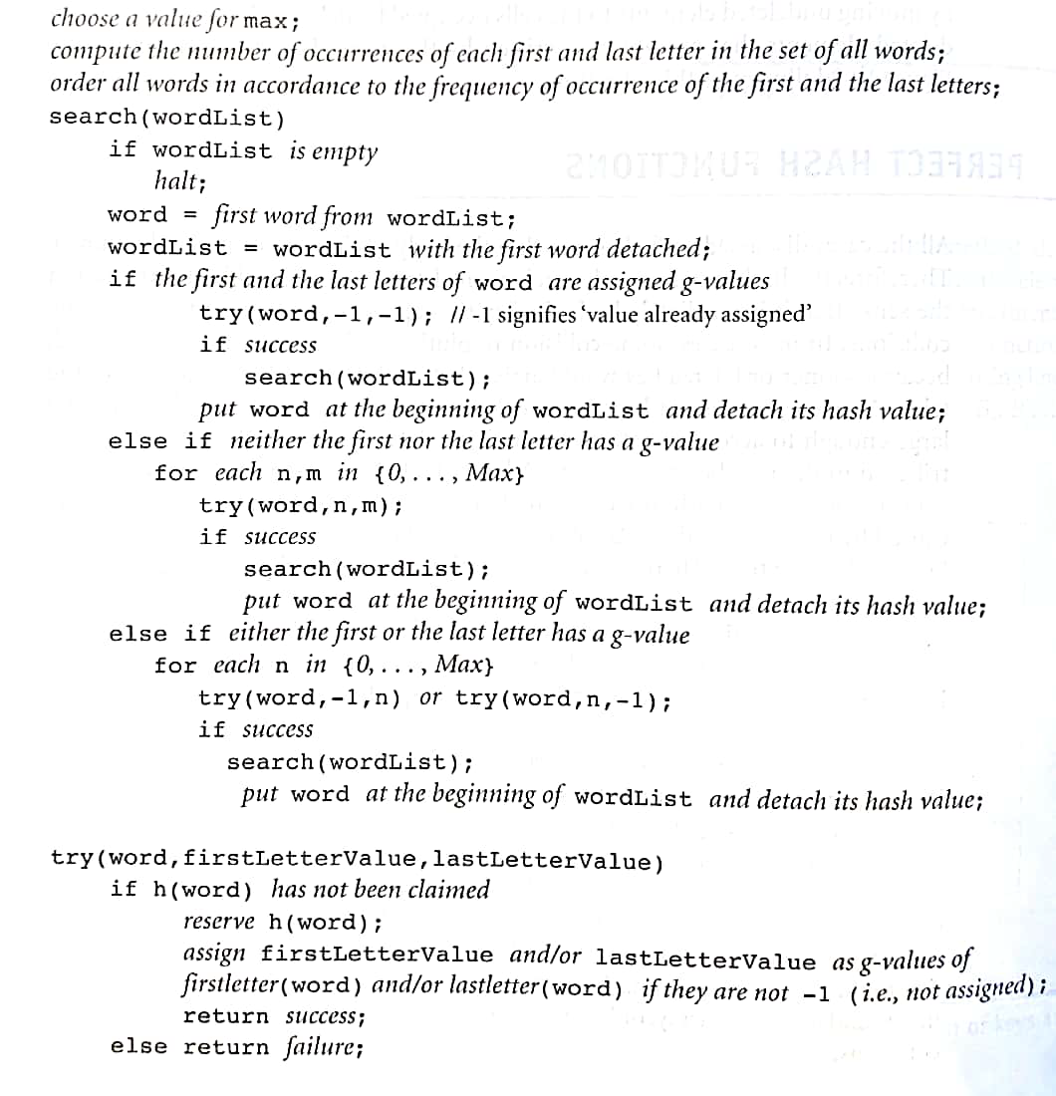
Cichelli’s Method

Slide 5
Illustrating Perfect Hashing
•Use Cichelli's algorithm to build a minimal perfect hash
function for the following nine strings:
Calliope Clio Erato
Euterpe Melpomene Polyhymnia
Terpsichore Thalia Urania

Slide 6
•For Step 1 in the algorithm, we find the frequencies of the
first and last letter of each word to find:
C E O M P A T U
2 6 2 1 1 3 2 1
•Next we find the sum of the first and last letter of each word:
Calliope(2+6)=8, Clio(2+2)=4, Erato=8, Euterpe=12, Melpomene=7, Polyhymnia=4, Terpsichore=8, Thalia=5, Urania=4
•Sorting the keywords in decreasing frequency yields:
Euterpe Calliope Erato Terpsichore Melpomene Thalia Clio
12 8 8 8 7 5 4
Polyhymnia Urania
4 4
•We are now at step 5 of the algorithm, the heart of the algorithm.

Slide 7
TSize=9
Max=4
h(word) = (length(word) + g(first_letter(word)) + g(last_letter(word))) mod TSize
Word: Euterpe
 | 0
 | 1
 | 2
 | 3
 | 4
 | 5
 | 6
 | 7
 | 8
Length(Word): 7
Euterpe
Calliope
Erato
Terpsichore
Melpomene
Thalia
Clio
Polyhymnia
Urania
g(First_Letter=E): 0
g(Last_Letter=e): 0
 | g-value
C | 0
E | 0
O | 0
M | 0
P | 0
A | 0
T | 0
U | 0
Sum= 7
Mod 9= 7
Euterpe

Slide 8
TSize=9
Max=4
h(word) = (length(word) + g(first_letter(word)) + g(last_letter(word))) mod TSize
Word: Calliope
 | 0
 | 1
 | 2
 | 3
 | 4
 | 5
 | 6
 | 7
 | 8
Length(Word): 8
Euterpe(7)
Calliope
Erato
Terpsichore
Melpomene
Thalia
Clio
Polyhymnia
Urania
g(First_Letter=C): 0
g(Last_Letter=e): 0
 | g-value
C | 0
E | 0
O | 0
M | 0
P | 0
A | 0
T | 0
U | 0
Sum= 8
Mod 9= 8
Euterpe
Calliope

Slide 9
TSize=9
Max=4
h(word) = (length(word) + g(first_letter(word)) + g(last_letter(word))) mod TSize
Word: Erato
 | 0
 | 1
 | 2
 | 3
 | 4
 | 5
 | 6
 | 7
 | 8
Length(Word): 5
Euterpe(7)
Calliope(8)
Erato
Terpsichore
Melpomene
Thalia
Clio
Polyhymnia
Urania
g(First_Letter=E): 0
g(Last_Letter=o): 0
 | g-value
C | 0
E | 0
O | 0
M | 0
P | 0
A | 0
T | 0
U | 0
Sum= 5
Mod 9= 5
Erato
Euterpe
Calliope

Slide 10
TSize=9
Max=4
h(word) = (length(word) + g(first_letter(word)) + g(last_letter(word))) mod TSize
Word: Terpsichore
 | 0
 | 1
 | 2
 | 3
 | 4
 | 5
 | 6
 | 7
 | 8
Length(Word): 11
Euterpe(7)
Calliope(8)
Erato(5)
Terpsichore
Melpomene
Thalia
Clio
Polyhymnia
Urania
g(First_Letter=T): 0
g(Last_Letter=e): 0
Terpsichore
 | g-value
C | 0
E | 0
O | 0
M | 0
P | 0
A | 0
T | 0
U | 0
Sum= 11
Mod 9= 2
Erato
Euterpe
Calliope

Slide 11
TSize=9
Max=4
h(word) = (length(word) + g(first_letter(word)) + g(last_letter(word))) mod TSize
Word: Melpomene
 | 0
 | 1
 | 2
 | 3
 | 4
 | 5
 | 6
 | 7
 | 8
Melpomene
Length(Word): 9
Euterpe(7)
Calliope(8)
Erato(5)
Terpsichore(2)
Melpomene
Thalia
Clio
Polyhymnia
Urania
g(First_Letter=M): 0
g(Last_Letter=e): 0
Terpsichore
 | g-value
C | 0
E | 0
O | 0
M | 0
P | 0
A | 0
T | 0
U | 0
Sum= 9
Mod 9= 0
Erato
Euterpe
Calliope

Slide 12
TSize=9
Max=4
h(word) = (length(word) + g(first_letter(word)) + g(last_letter(word))) mod TSize
Word: Thalia
 | 0
 | 1
 | 2
 | 3
 | 4
 | 5
 | 6
 | 7
 | 8
Melpomene
Length(Word): 6
Euterpe(7)
Calliope(8)
Erato(5)
Terpsichore(2)
Melpomene(0)
Thalia
Clio
Polyhymnia
Urania
g(First_Letter=T): 0
g(Last_Letter=a): 0
Terpsichore
 | g-value
C | 0
E | 0
O | 0
M | 0
P | 0
A | 0
T | 0
U | 0
Sum= 6
Mod 9= 6
Erato
Thalia
Euterpe
Calliope

Slide 13
TSize=9
Max=4
h(word) = (length(word) + g(first_letter(word)) + g(last_letter(word))) mod TSize
Word: Clio
 | 0
 | 1
 | 2
 | 3
 | 4
 | 5
 | 6
 | 7
 | 8
Melpomene
Length(Word): 4
Euterpe(7)
Calliope(8)
Erato(5)
Terpsichore(2)
Melpomene(0)
Thalia(6)
Clio
Polyhymnia
Urania
g(First_Letter=C): 0
g(Last_Letter=o): 0
Terpsichore
 | g-value
C | 0
E | 0
O | 0
M | 0
P | 0
A | 0
T | 0
U | 0
Sum= 4
Mod 9= 4
Clio
Erato
Thalia
Euterpe
Calliope

Slide 14
TSize=9
Max=4
h(word) = (length(word) + g(first_letter(word)) + g(last_letter(word))) mod TSize
Word: Polyhymnia
 | 0
 | 1
 | 2
 | 3
 | 4
 | 5
 | 6
 | 7
 | 8
Melpomene
Length(Word): 10
Euterpe(7)
Calliope(8)
Erato(5)
Terpsichore(2)
Melpomene(0)
Thalia(6)
Clio(4)
Polyhymnia
Urania
Polyhymnia
g(First_Letter=P): 0
g(Last_Letter=a): 0
Terpsichore
 | g-value
C | 0
E | 0
O | 0
M | 0
P | 0
A | 0
T | 0
U | 0
Sum= 10
Mod 9= 1
Clio
Erato
Thalia
Euterpe
Calliope

Slide 15
TSize=9
Max=4
h(word) = (length(word) + g(first_letter(word)) + g(last_letter(word))) mod TSize
Word: Urania
 | 0
 | 1
 | 2
 | 3
 | 4
 | 5
 | 6
 | 7
 | 8
Melpomene
Length(Word): 6
Euterpe(7)
Calliope(8)
Erato(5)
Terpsichore(2)
Melpomene(0)
Thalia(6)
Clio(4)
Polyhymnia(1)
Urania
Polyhymnia
1
2
3
4
g(First_Letter=U): 0
g(Last_Letter=a): 0
Hash clash !
Terpsichore
 | g-value
C | 0
E | 0
O | 0
M | 0
P | 0
A | 0
T | 0
U | 0
Hash clash !
Sum= 6
Mod 9= 6
1
7
8
0
Clio
Hash clash !
Erato
Hash clash !
Hash clash !
G-value is max but we still haven’t found a solution
Thalia
Euterpe
Reset g-value and step back (to Polyhymnia)
Calliope
1
2
3
4

Slide 16
TSize=9
Max=4
h(word) = (length(word) + g(first_letter(word)) + g(last_letter(word))) mod TSize
Word: Polyhymnia
 | 0
 | 1
 | 2
 | 3
 | 4
 | 5
 | 6
 | 7
 | 8
Melpomene
Length(Word): 10
Euterpe(7)
Calliope(8)
Erato(5)
Terpsichore(2)
Melpomene(0)
Thalia(6)
Clio(4)
Polyhymnia
Urania
2
g(First_Letter=P): 1
g(Last_Letter=a): 0
Terpsichore
 | g-value
C | 0
E | 0
O | 0
M | 0
P | 0
A | 0
T | 0
U | 0
Hash clash !
Sum= 11
12
Polyhymnia
Mod 9= 2
3
Clio
Erato
Thalia
Euterpe
1
2
Calliope

Slide 17
TSize=9
Max=4
h(word) = (length(word) + g(first_letter(word)) + g(last_letter(word))) mod TSize
Word: Urania
 | 0
 | 1
 | 2
 | 3
 | 4
 | 5
 | 6
 | 7
 | 8
Melpomene
Length(Word): 6
Euterpe(7)
Calliope(8)
Erato(5)
Terpsichore(2)
Melpomene(0)
Thalia(6)
Clio(4)
Polyhymnia(3)
Urania
Urania
1
2
3
4
g(First_Letter=U): 0
g(Last_Letter=a): 0
Hash clash !
 | g-value
C | 0
E | 0
O | 0
M | 0
P | 2
A | 0
T | 0
U | 0
Terpsichore
Sum= 6
Polyhymnia
Mod 9= 6
1
7
8
0
Clio
Hash clash !
Erato
Hash clash !
Hash clash !
Thalia
Euterpe
Calliope
1
2
3
4

Slide 18
Cichelli's Algorithm: Comments
•The search process in this algorithm is exponential.
•The algorithm is applicable to small sets of strings.
•It does not guarantee that a perfect hash function can be found.
•Program usually run only once and result incorporated into another program.
•There are extensions to this technique that avoid its limitations.
•For our purpose in this course, the Cichelli's algorithm is sufficient.

Slide 19
Hash Functions for Extendible Files
•There are two categories of hashing: Static hashing (the hash table is fixed-sized), and Dynamic/Extendible hashing.
•Dynamic/Extendible hashing: splits and coalesces buckets appropriately with the database size.
–i.e. buckets are added and deleted on demand.
–The hash function typically produces a large number of values, uniformly and randomly.
–Only part of the value is used depending on the size of the database.
–Hash indices are typically a prefix of the entire hash value.
–More than one consecutive index can point to the same bucket.

Slide 20
Extendible Hashing
Is a type of hash system which treats a hash as a bit string, and uses a trie for bucket lookup
Accesses the data stored in buckets indirectly through an index (that is dynamically adjusted)
Allows the file to expand without reorganizing it, but requires storage space for an index
Values returned by such a hash function are called Pseudokeys

Slide 21
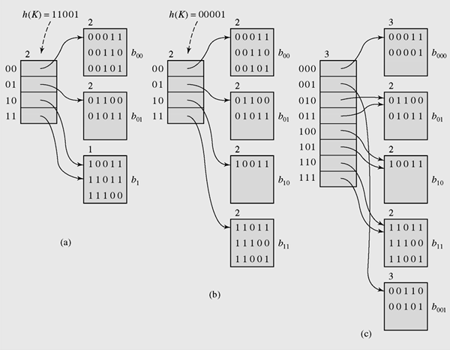
Local depth
Directories depth
Directories
Bucket
Overflow:
If directory depth < local depth: new bucket
If directory depth = local depth: double directory
An example of extendible hashing

